Slide 1
Stock Price Time Series Forecast: Exploratory Data Analytics
Group 8: Ahmad Javed, Steven Sullivan, Robert Lignowski, Uditi Shah

Slide 2
Project Summary/ Recap
Our project details the acquisition and preprocessing of historical stock data for Ford, Volkswagen, Toyota, and Tesla from Investing.com. We selected these companies to analyze trends in both traditional and electric vehicle markets. The acquisition process involved downloading structured CSV files, ensuring consistency, and standardizing formats for accurate analysis. During preprocessing, we handled missing values, inconsistent volume formatting, and data noise using statistical methods like median imputation and numerical conversions. Standardizing date formats enabled effective time-series analysis, ensuring data integrity for predictive modeling and financial insights.

Slide 3
Exploratory Data Analysis
Data Overview:
Source: Investing.com & Microsoft Excel
Date Range: Jan 2, 2020 – Jan 2, 2025
Features: Close, Open, High, Low, Volume, % Change
Data Cleaning & Processing:
Converted date to datetime format
Cleaned Volume & % Change columns
Ensured no missing values

Slide 4
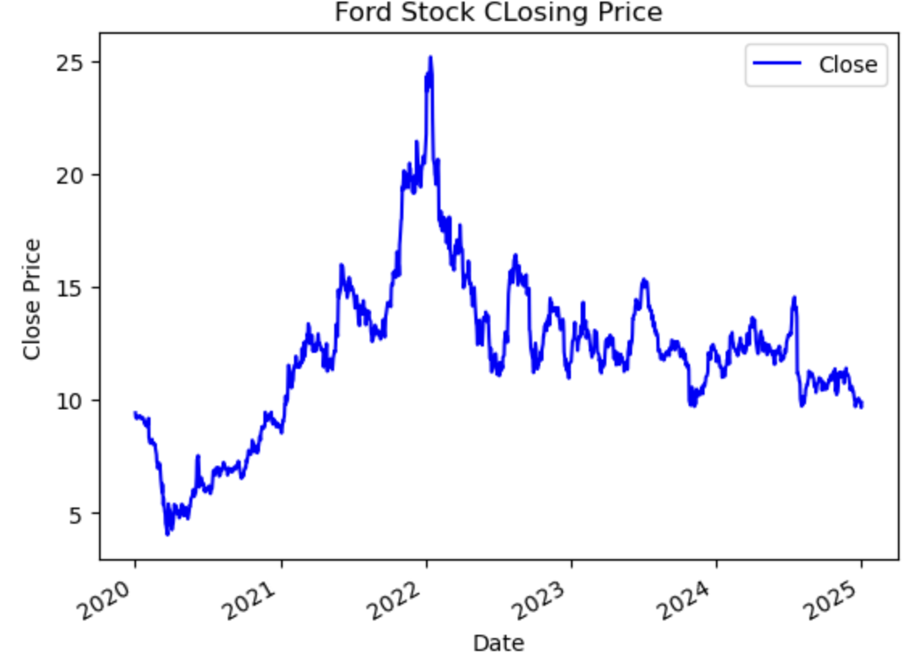
Exploratory Data Analysis
Key Insights:
Stock Trend: Fluctuations observed over five years
Volume Trends: Spikes during major market events
Closing Price Distribution: Normal with outliers
Correlation: High correlation among price features
Visualizations:
Line Charts: Closing price & volume trends
Histograms: Price & volume distribution
Box Plot: Outlier detection
Heatmap: Feature correlations

Slide 5
Purpose of Feature Engineering
Why Feature Engineering?
Transforms raw stock data into more meaningful inputs.
Helps models recognize trends, seasonality, and volatility.
Reduces redundancy by removing highly correlated features.

Slide 6
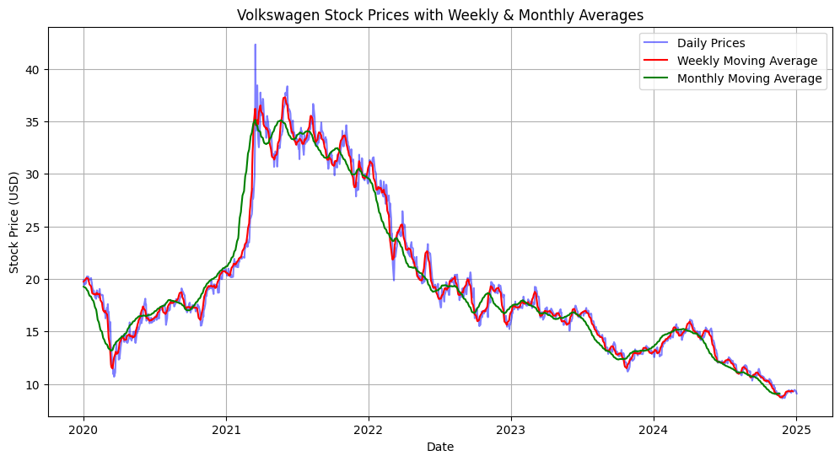
Rolling Averages & Trend Smoothing
Key Features Created:
Weekly & Monthly Moving Averages: Smoothed price trends.
Trend Extraction: Identified long-term stock movements.
Volatility Measures: Quantified price fluctuations.

Slide 7
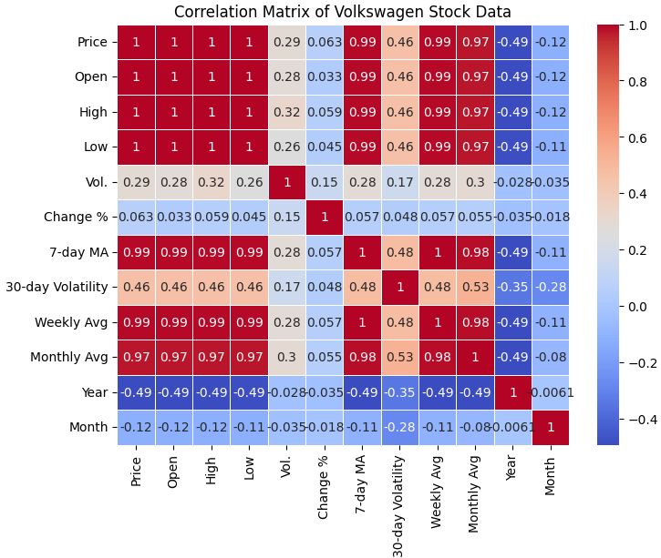
Correlation Analysis & Feature Selection
Findings from Correlation Analysis:
High correlation among Open, High, Low, and Close prices → Some features removed.
Trading Volume had weak correlation with stock prices.
7-day Moving Average & 30-day Volatility retained as meaningful features.

Slide 8
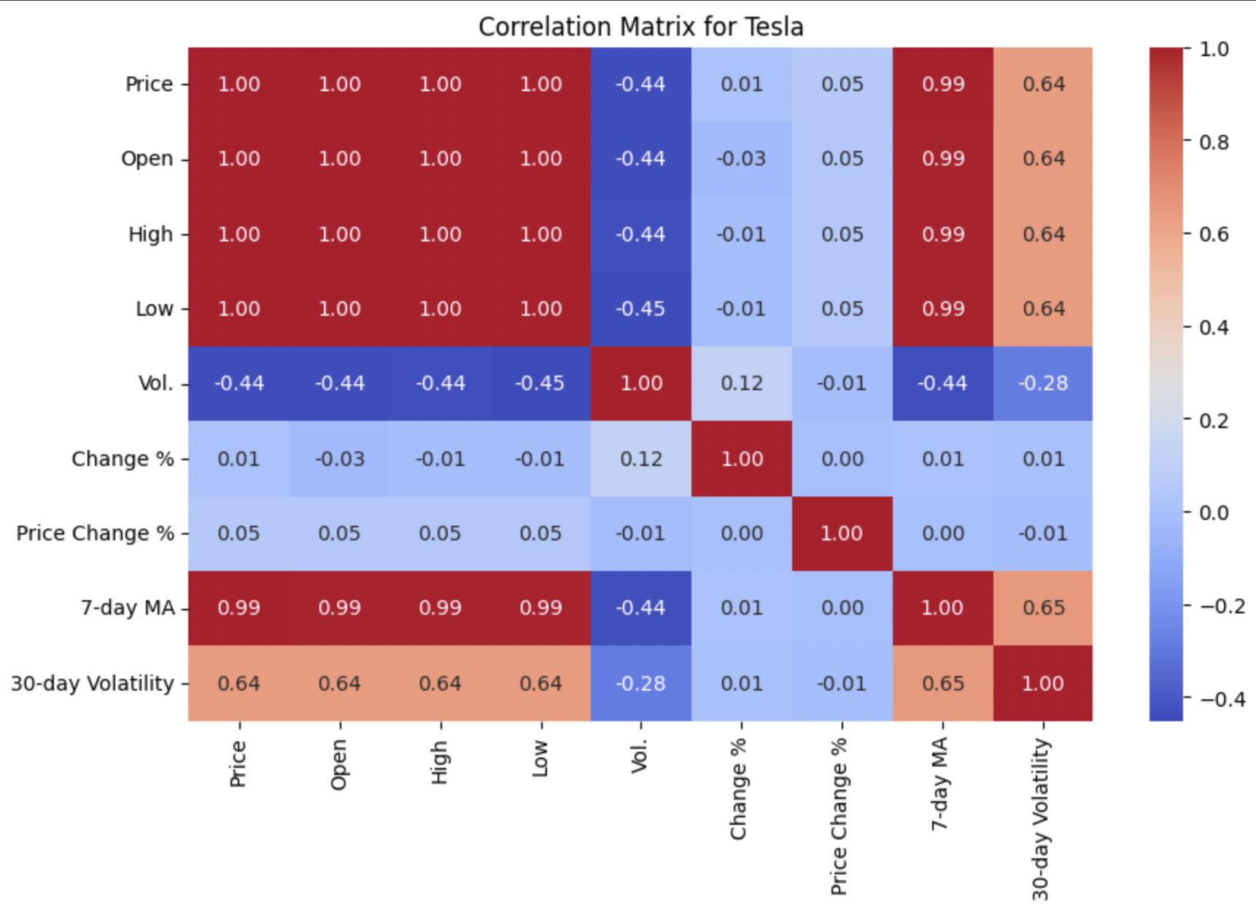
Impact of Feature Engineering
Key Takeaways from Feature Engineering:
Improved Trend Detection: Rolling averages reduced short-term noise.
Stronger Predictive Power: Selected key features while removing redundancies.
More Efficient Model: Simplified dataset, making training faster.

Slide 9
Finalized Data
Cleaned, and verified
Converted to datetime
Dropped missing variables
Taken steps to deal with leakage
Created lagging features
Lagging features are important for time series forecasting
Help show trends and seasonality
Enable models to learn from past behavior
Data leakage interferes with lagging because it inserts data from the “future” into the analysis
Therefore, it is helpful to shift the data slightly so only data from before a certain point is used.
Splitting
Splitting data into training (80%) and testing (20%)

Slide 10
Next Step: Pipeline Model
Time Series Forecasting
Using historical data to predict future values
In this case, looking at trends in stock prices to predict future prices
Different approaches to choose from
ARIMA - AutoRegressive Integrated Moving Average
Statistical model used for analyzing and forecasting time series data by combining autoregression, differencing, and moving averages to capture patterns over time.
Other Machine learning models
Linear Regression
Random forest
XGBoost
LSTM (Long Short-Term Memory)

Slide 11
Key Lessons: Data Acquisition and Preprocessing
Ensuring the data is clean and consistent is crucial for accurate analysis. Missing values in key columns such as volume and price can distort results. Addressing this by filling missing data with median values helps maintain the integrity of the dataset.
When working with multiple data sources (e.g., Ford, Volkswagen, Toyota, and Tesla), it's essential to standardize columns like volume and percentage change. This involves converting units (e.g., "M" for millions) and removing non-numeric characters to ensure consistency and comparability across datasets.
Outliers, identified through visualizations like box plots, can heavily influence stock price analysis. It's important to identify and address outliers to improve the accuracy and reliability of the results.

Slide 12
Key Lessons: Exploratory Data Analysis (EDA)
Visualizing data, such as stock prices and trading volumes over time, is key to identifying trends and spotting outliers. For example, spikes in trading activity and significant price movements on specific days provide valuable insights into market behavior.
By analyzing the correlations between variables, we identified which factors were most relevant for predictive modeling. This process helps reduce redundancy in the model and ensures that the focus is on the most impactful features.
Ensuring that the date column is formatted consistently is essential for time series analysis. Inconsistent date formats can lead to misalignment of data across different stocks, potentially disrupting the accuracy of the analysis.

Slide 13
Key Lessons: What Influences Car Stocks?
Macroeconomic Factors
Interest Rates
Inflation
Consumer Spending
Industry Specific Factors
Car Sales & Demands
EV Transition
Vehicle recalls
Market & Competitor Factors
Earning Reports
Mergers & Acquisitions
Partnerships
Government Policies & Regulations
Emission Standards
EV incentives (tax credits)
Trade policies & Tariffs
Global Events & Disruptions
Geopolitical Conflicts
Trade Wars
Pandemics

Slide 14
Next Steps
Date-Time Indexing
It’s crucial to index a dataset by date and ensure the date column is in the correct datetime format. This step is vital for time series analysis, as it preserves the order of data points.
Stationarity Check
ARIMA models require the time series to be stationary, meaning that its statistical properties, such as mean and variance, remain constant over time. Ensuring stationarity is a key step in preparing the data for accurate modeling.
Additional Analysis
To enhance predictive power, adding external data sources (e.g., news article, social media trends) related to the companies can provide additional insights
Model Validation:
It’s important to validate our model using unseen future data (January - March 2025) to ensure that our model performs well in predicting outcomes which will result in providing long-term accuracy.

